Slide 1
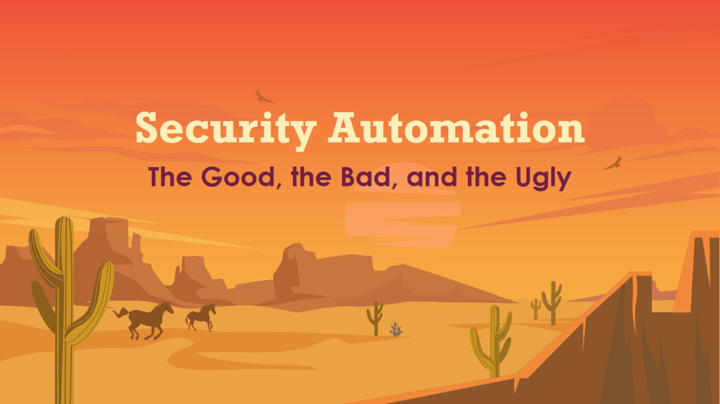
Security Automation

Slide 2
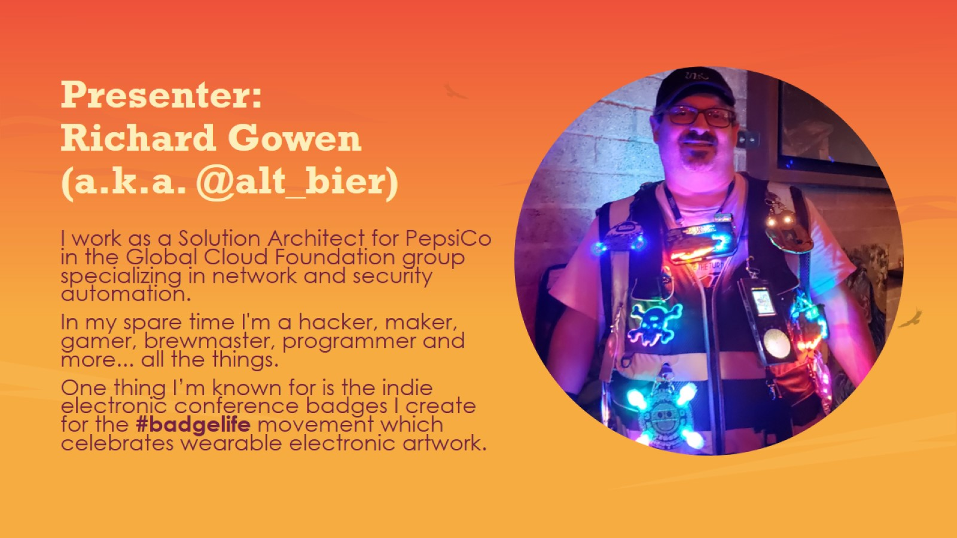
Presenter: Richard Gowen (a.k.a. @alt_bier)

Slide 3
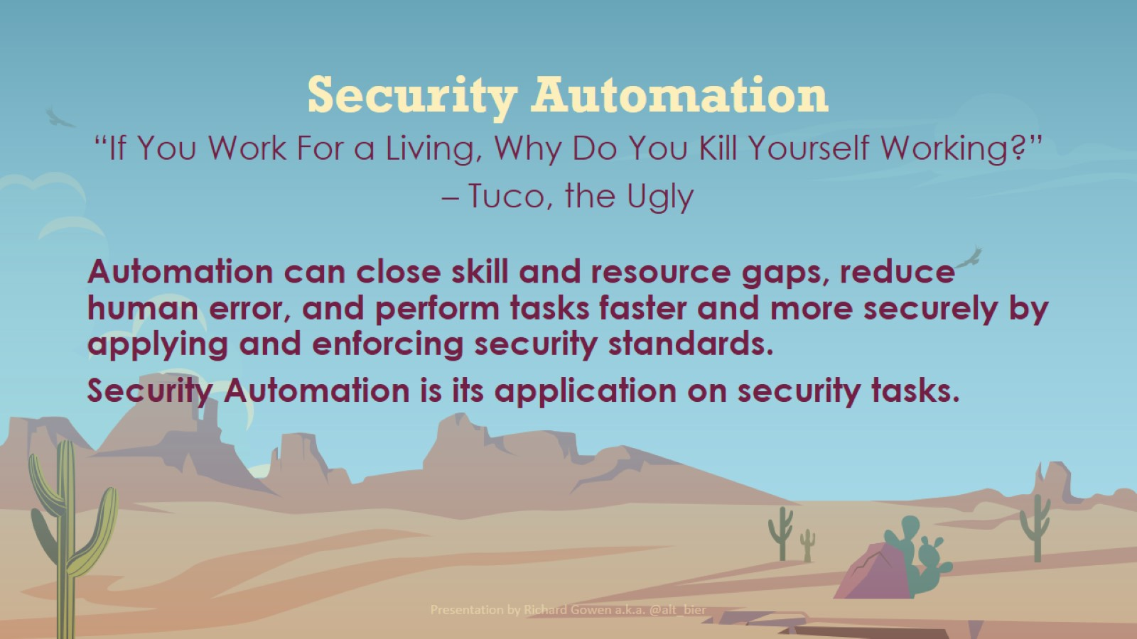
Security Automation

Slide 4
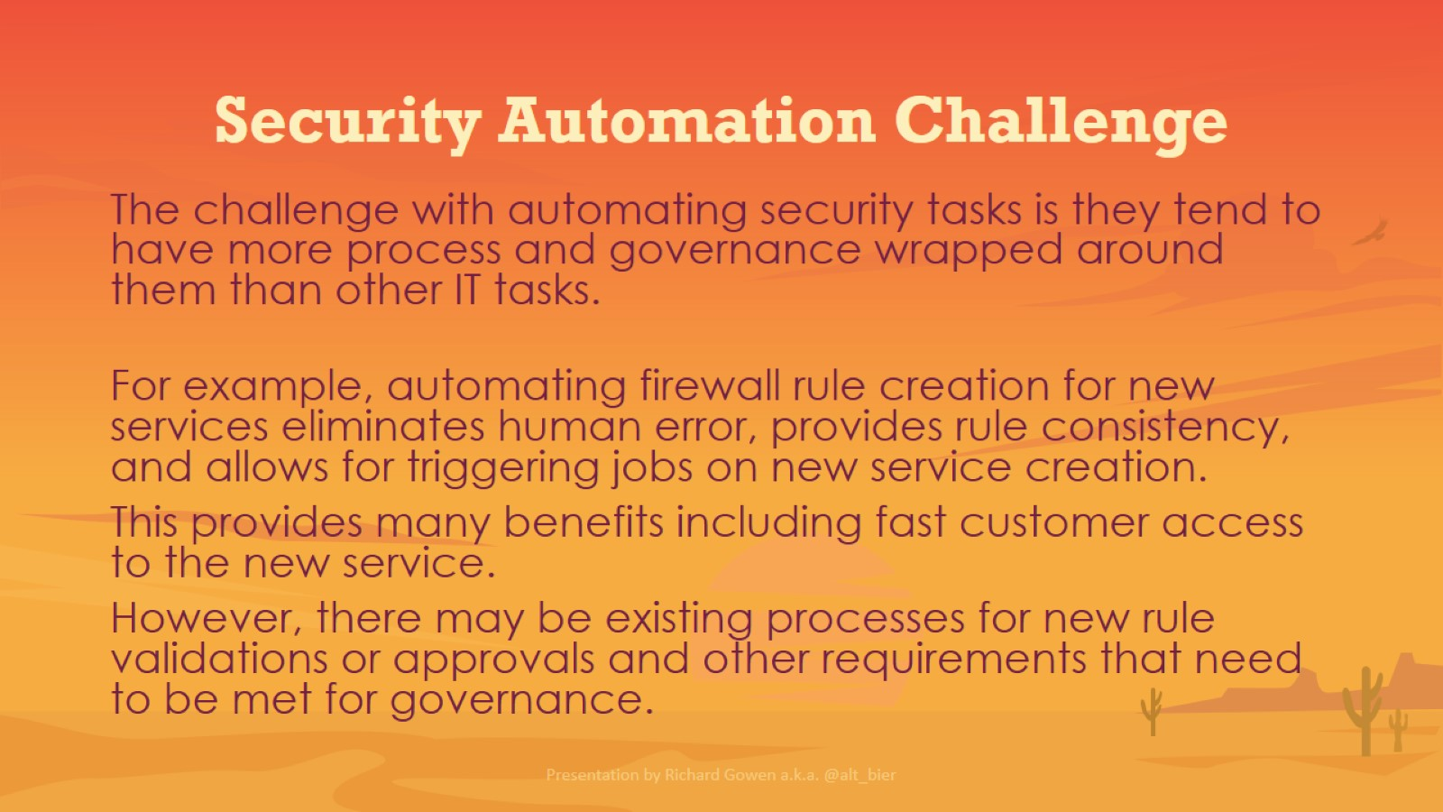
Security Automation Challenge

Slide 5
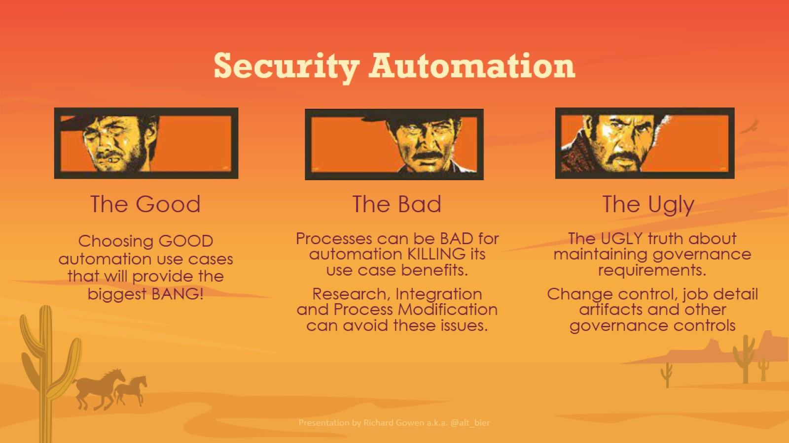
Security Automation

Slide 6
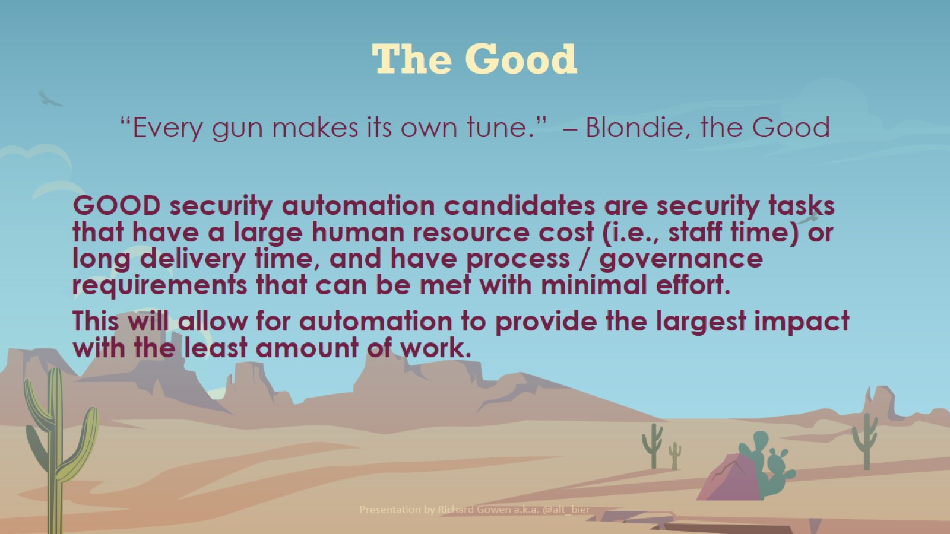
The Good

Slide 7
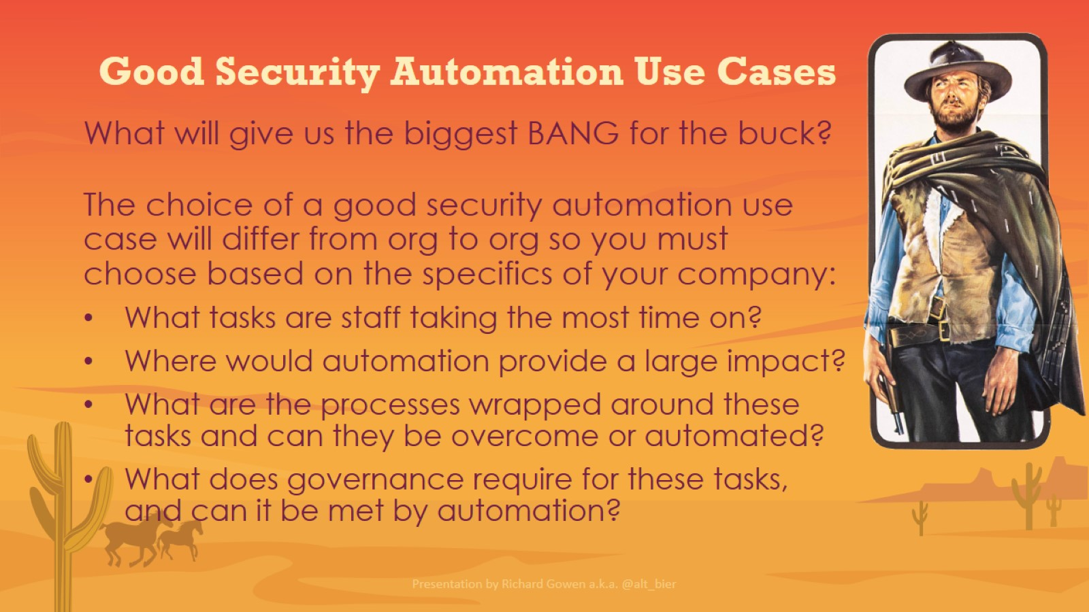
Good Security Automation Use Cases

Slide 8
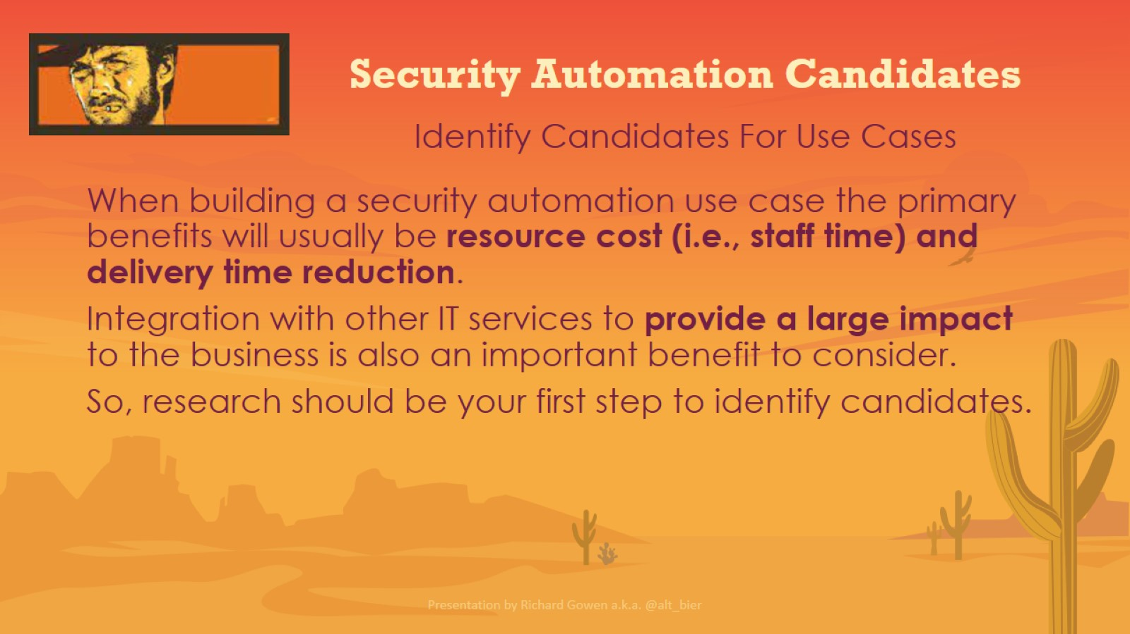
Security Automation Candidates

Slide 9
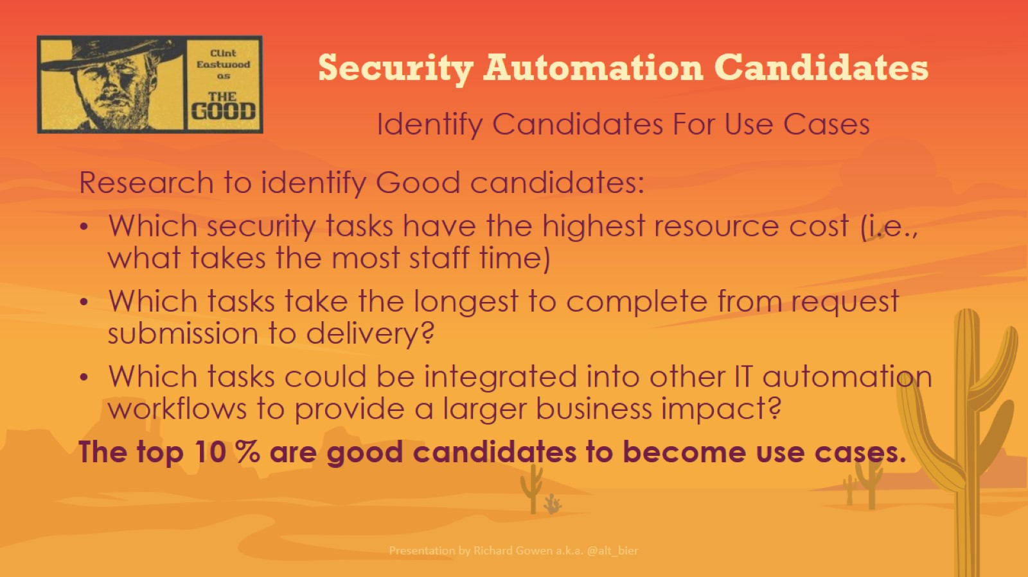
Security Automation Candidates

Slide 10
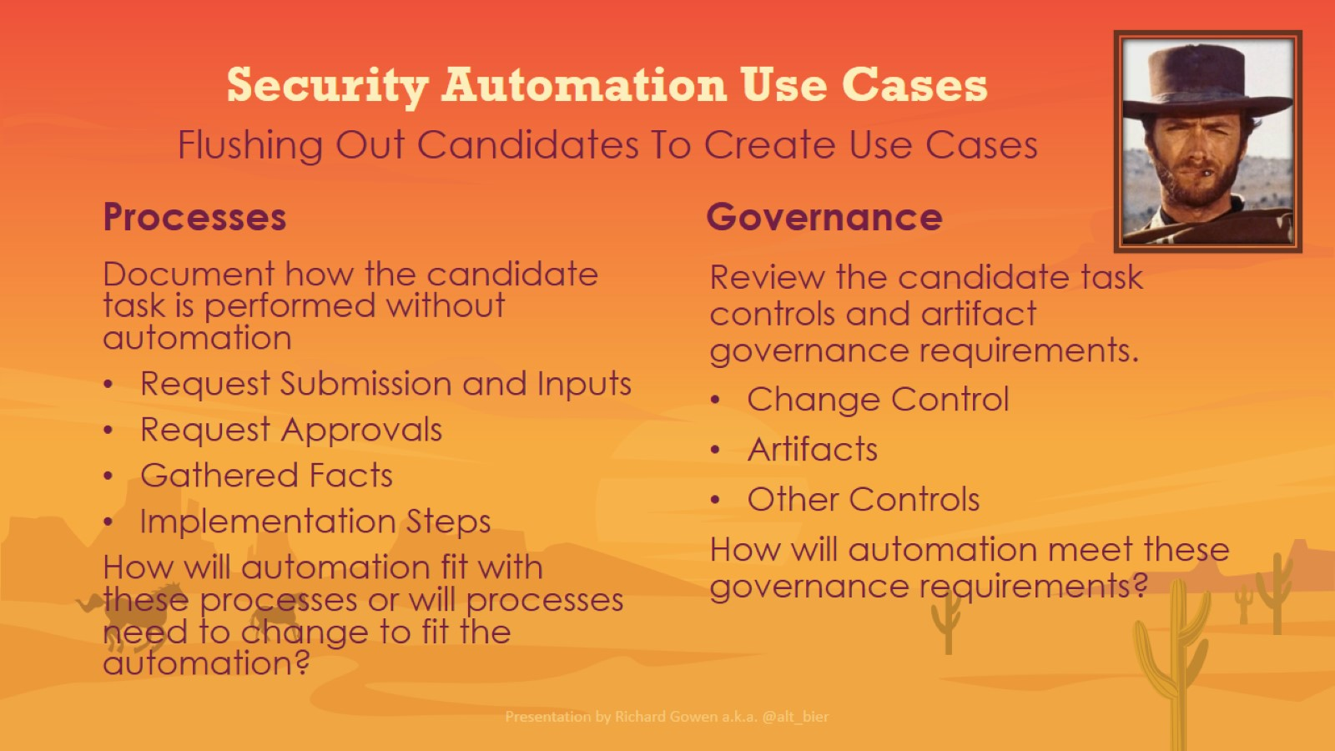
Security Automation Use Cases

Slide 11
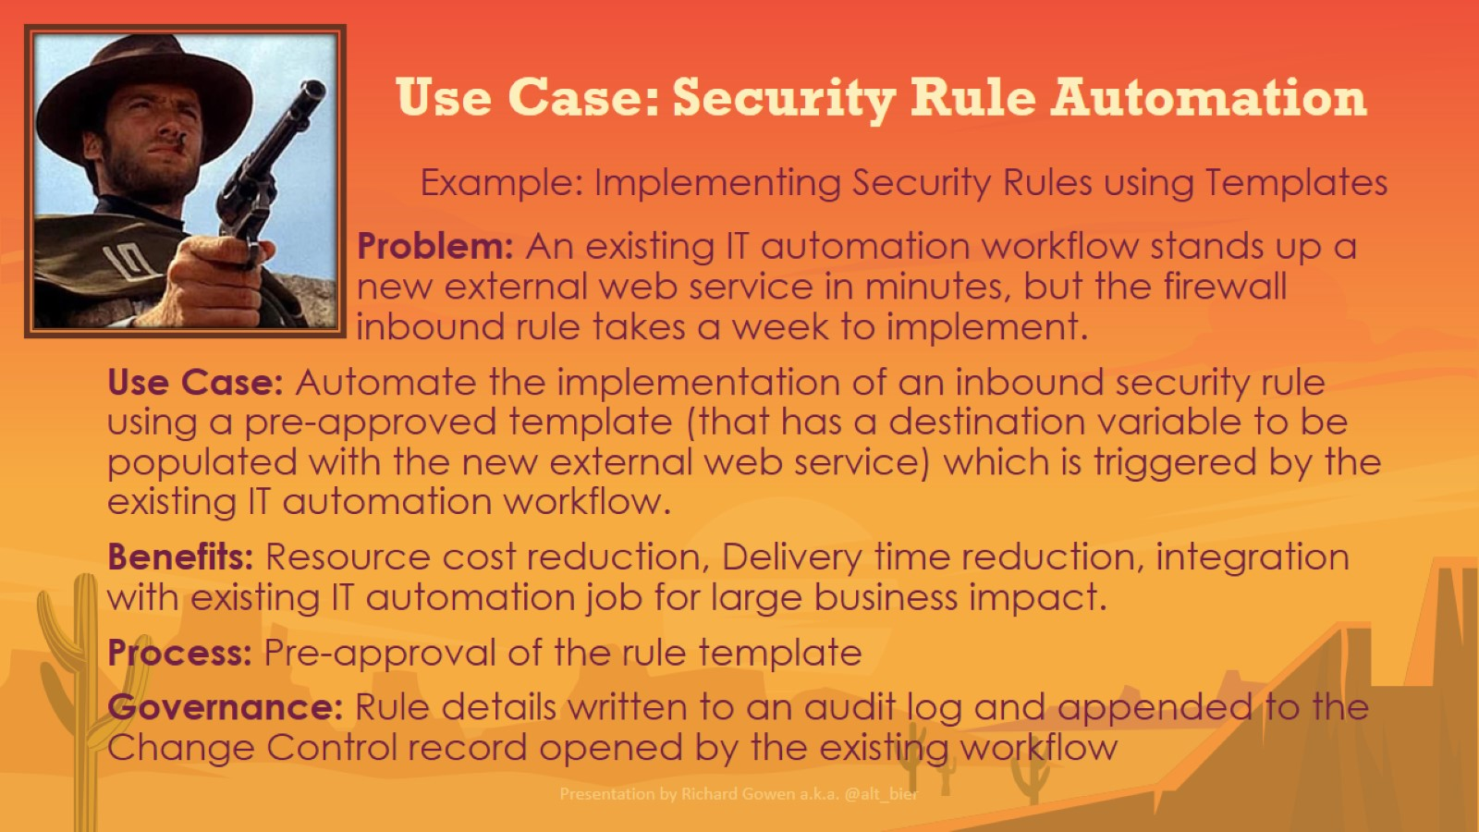
Use Case: Security Rule Automation

Slide 12
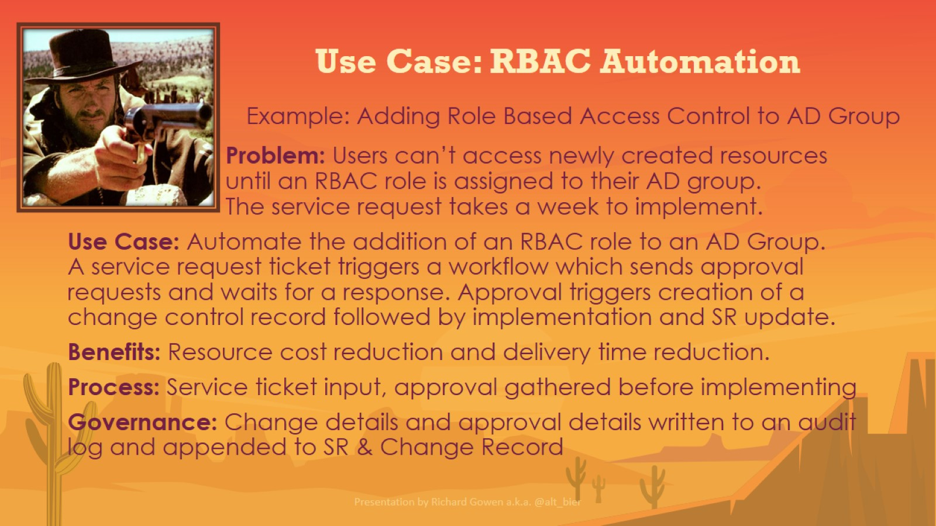
Use Case: RBAC Automation

Slide 13
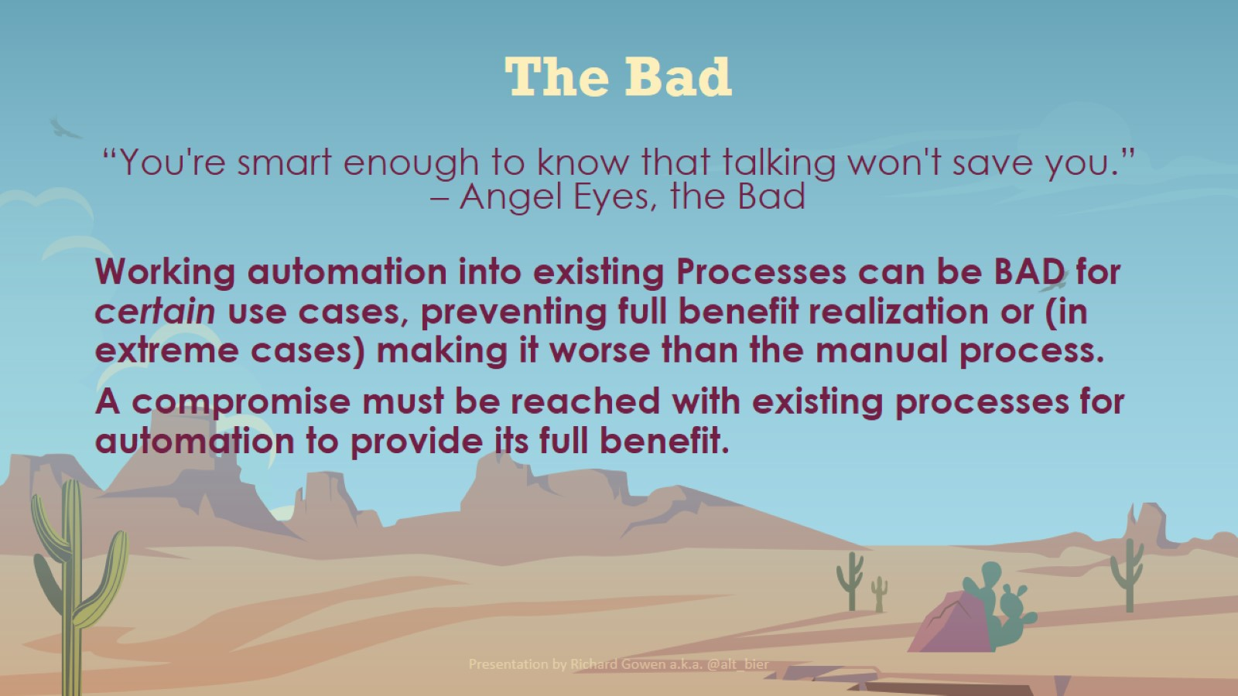
The Bad

Slide 14
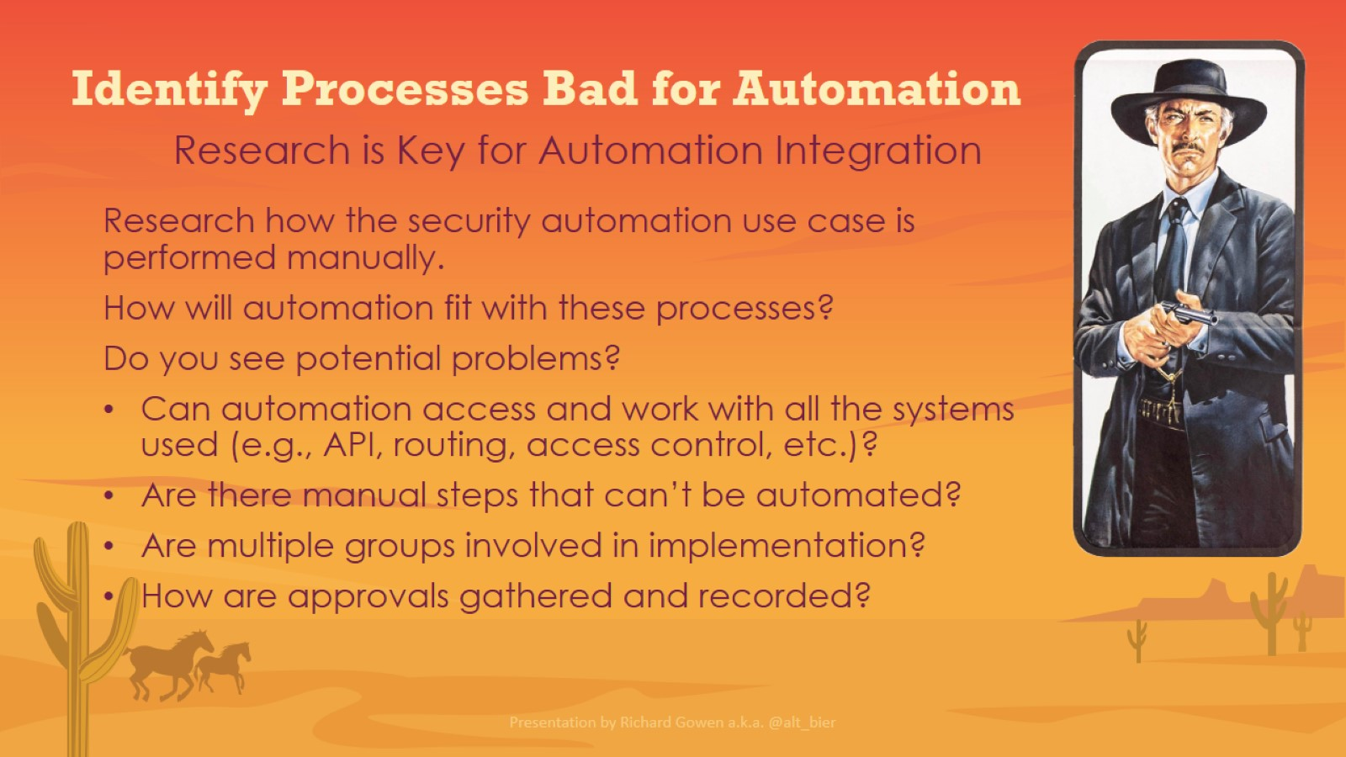
Identify Processes Bad for Automation

Slide 15
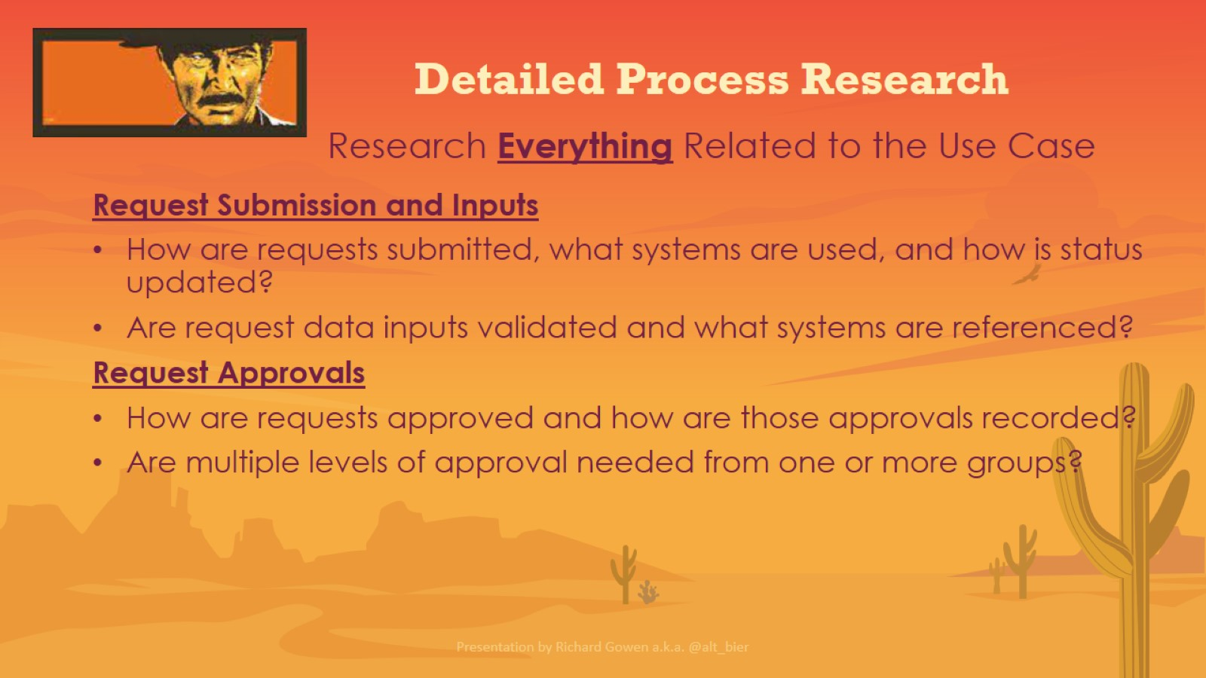
Detailed Process Research

Slide 16
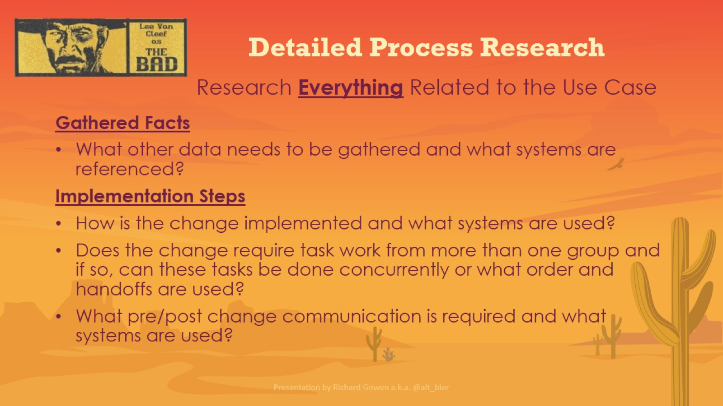
Detailed Process Research

Slide 17
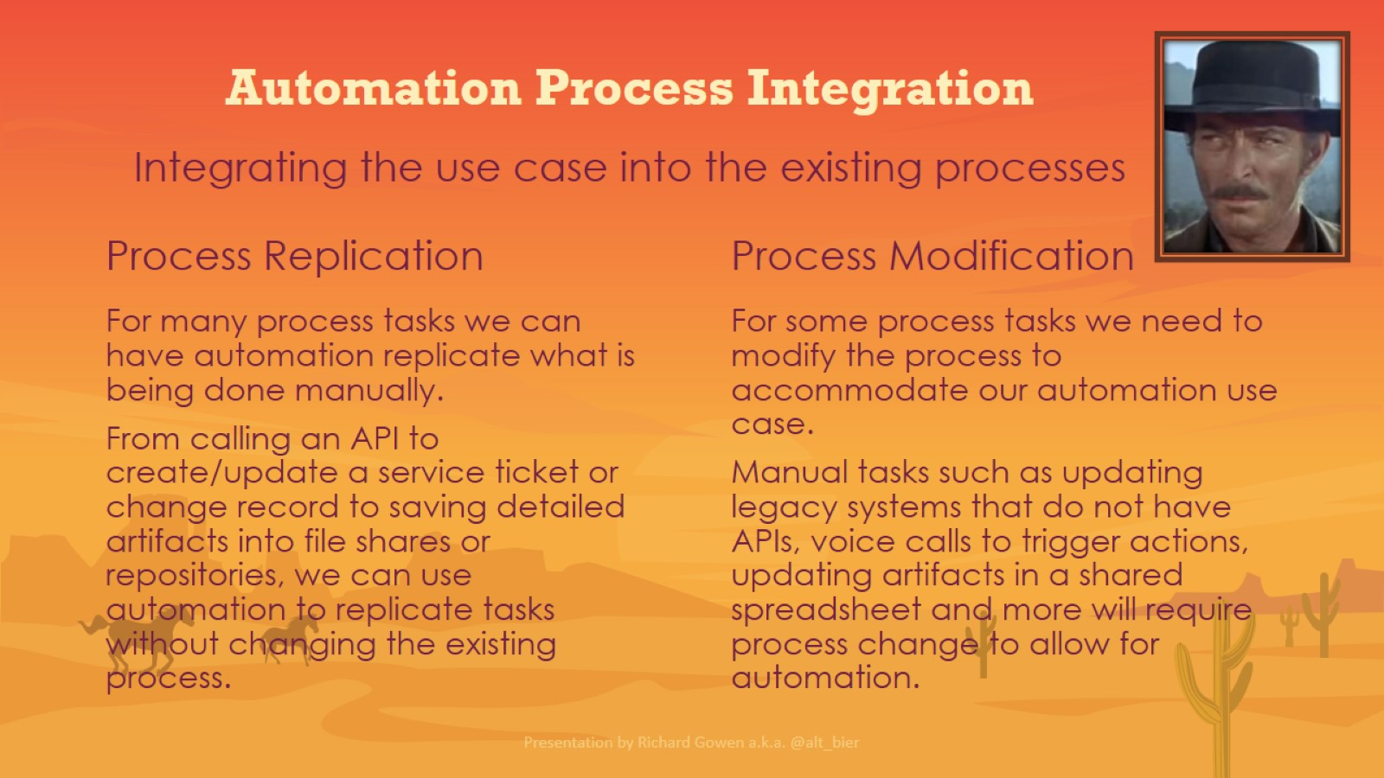
Automation Process Integration

Slide 18
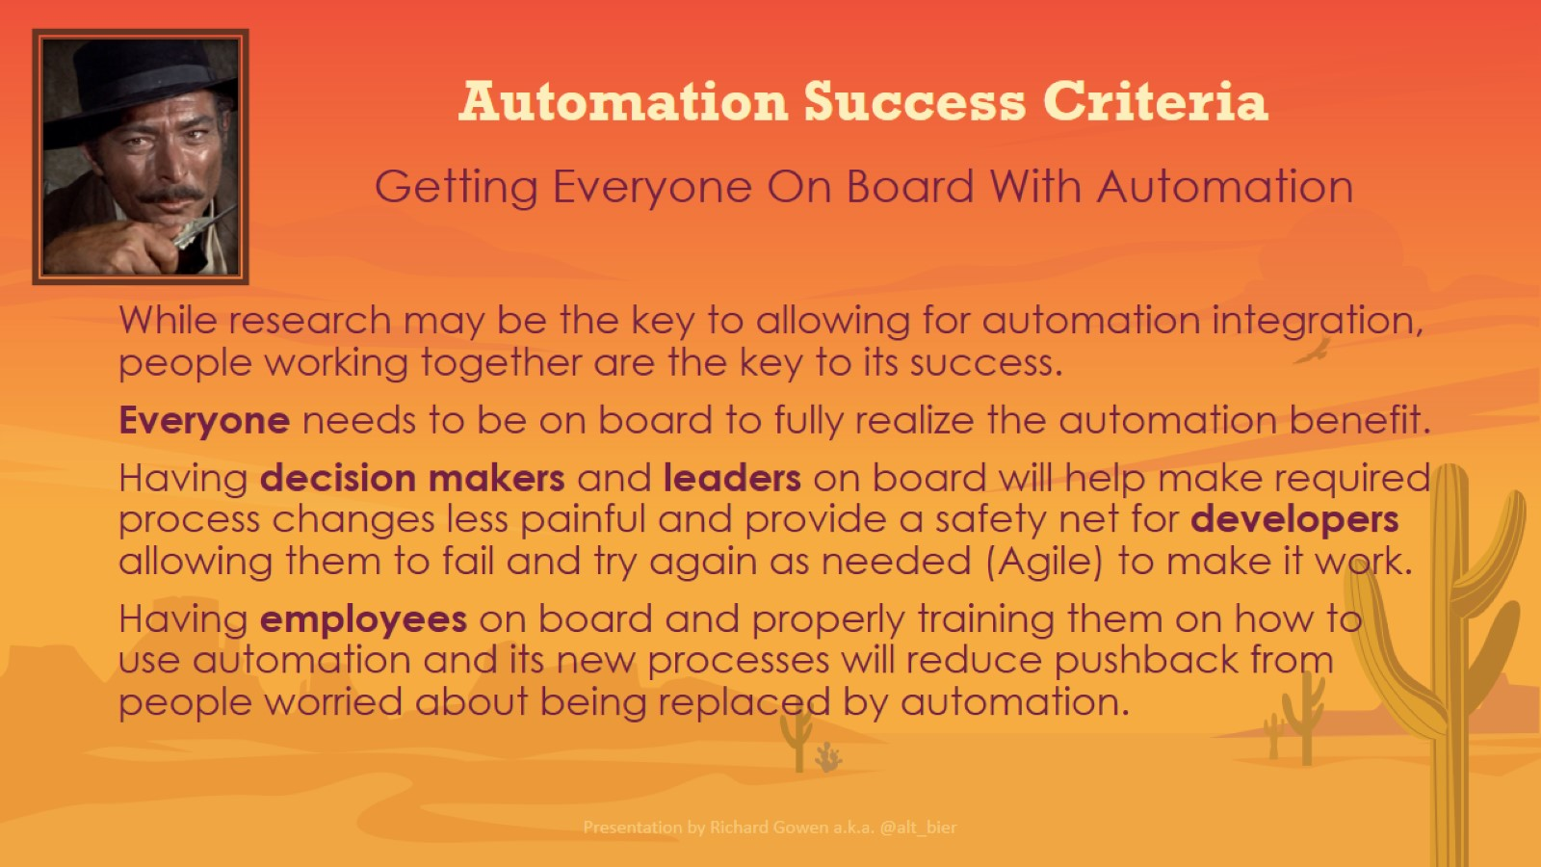
Automation Success Criteria

Slide 19
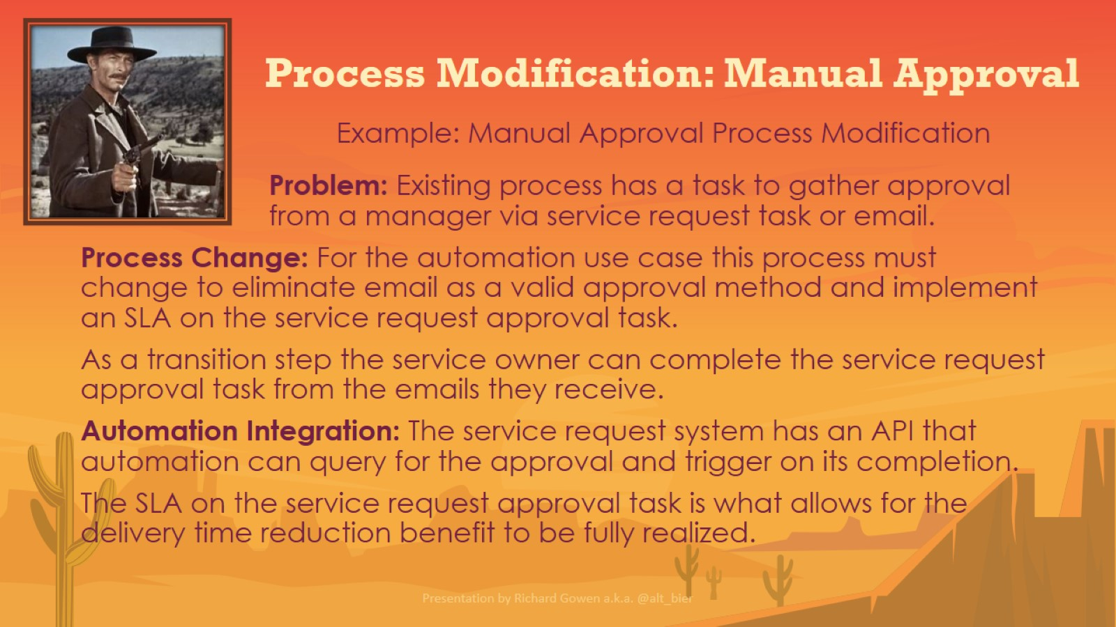
Process Modification: Manual Approval

Slide 20
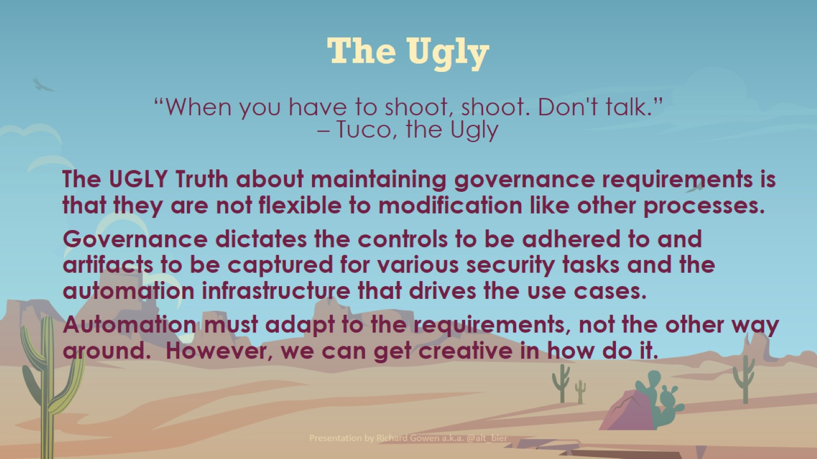
The Ugly

Slide 21
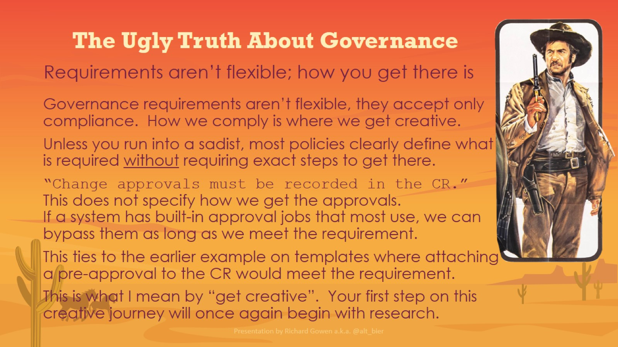
The Ugly Truth About Governance

Slide 22
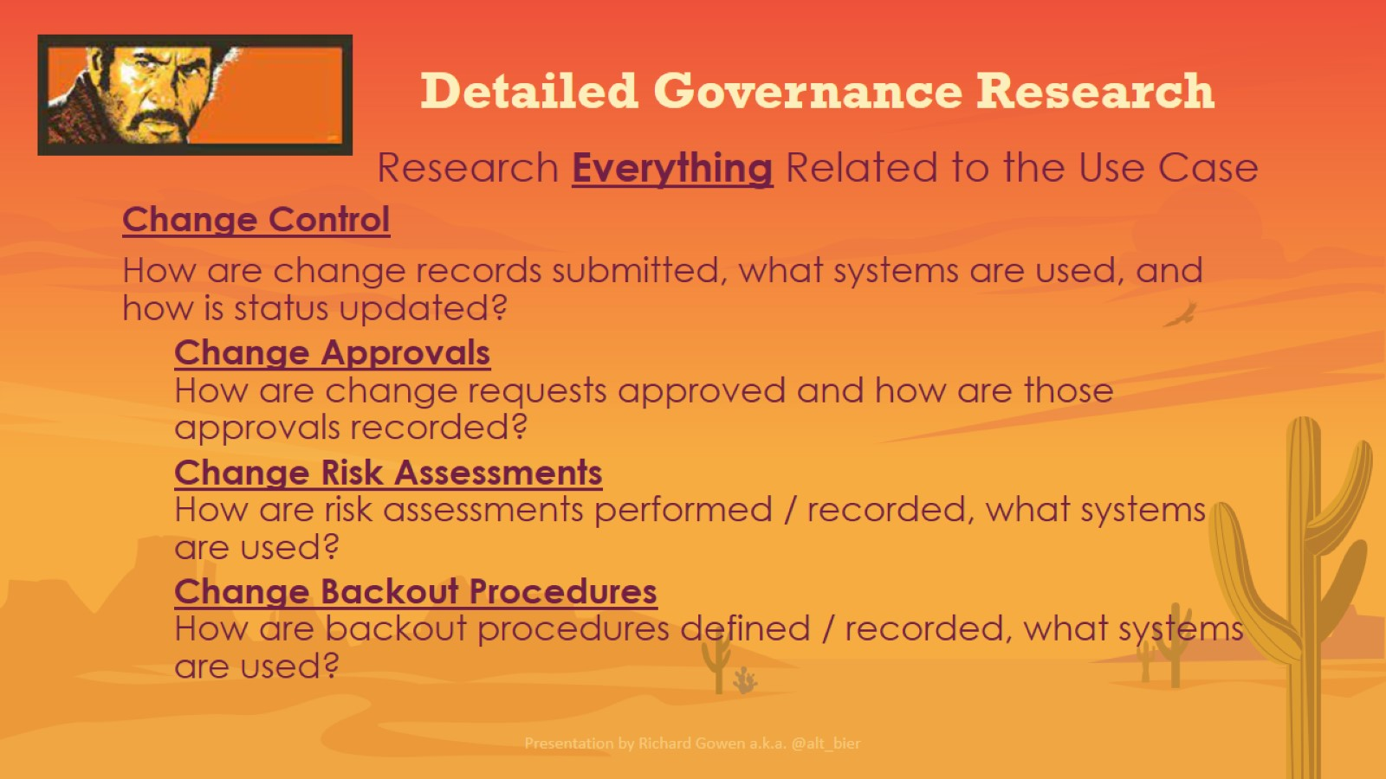
Detailed Governance Research

Slide 23
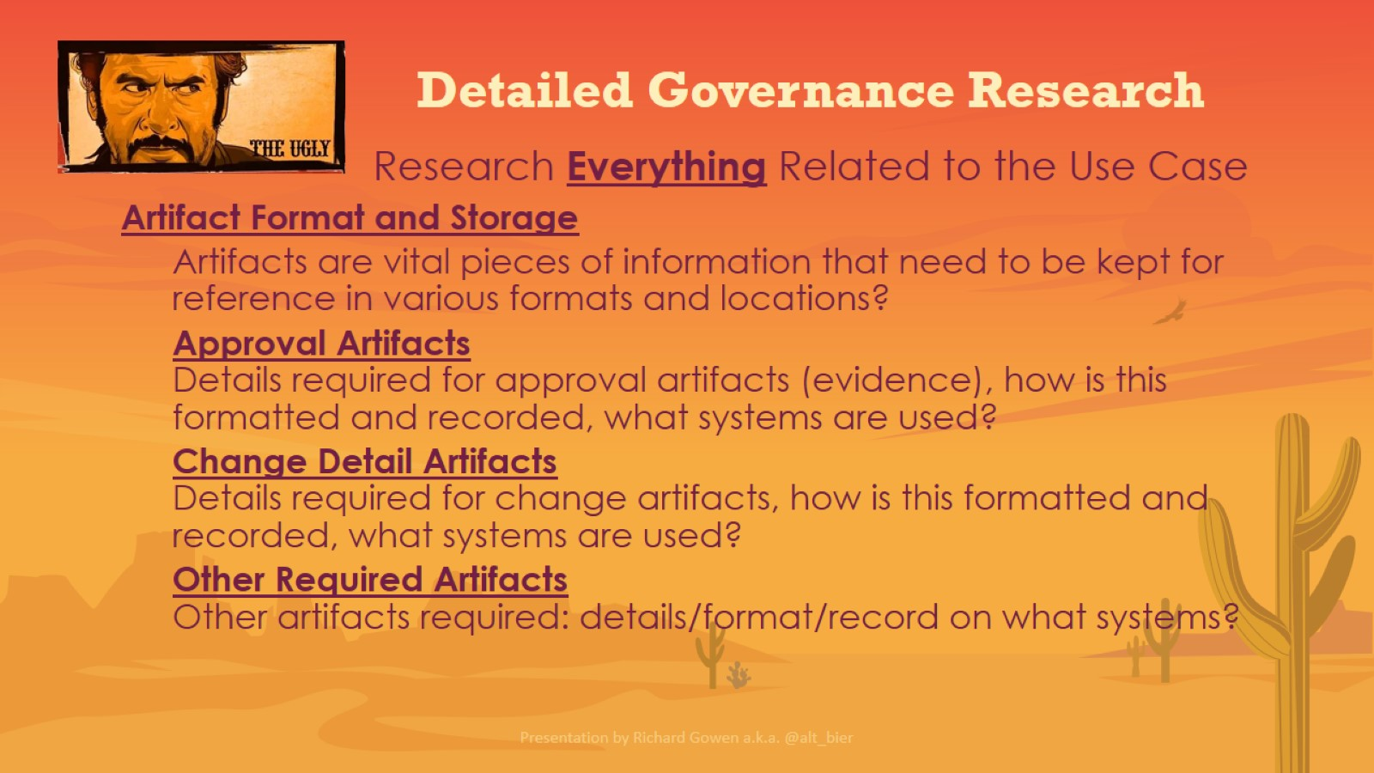
Detailed Governance Research

Slide 24
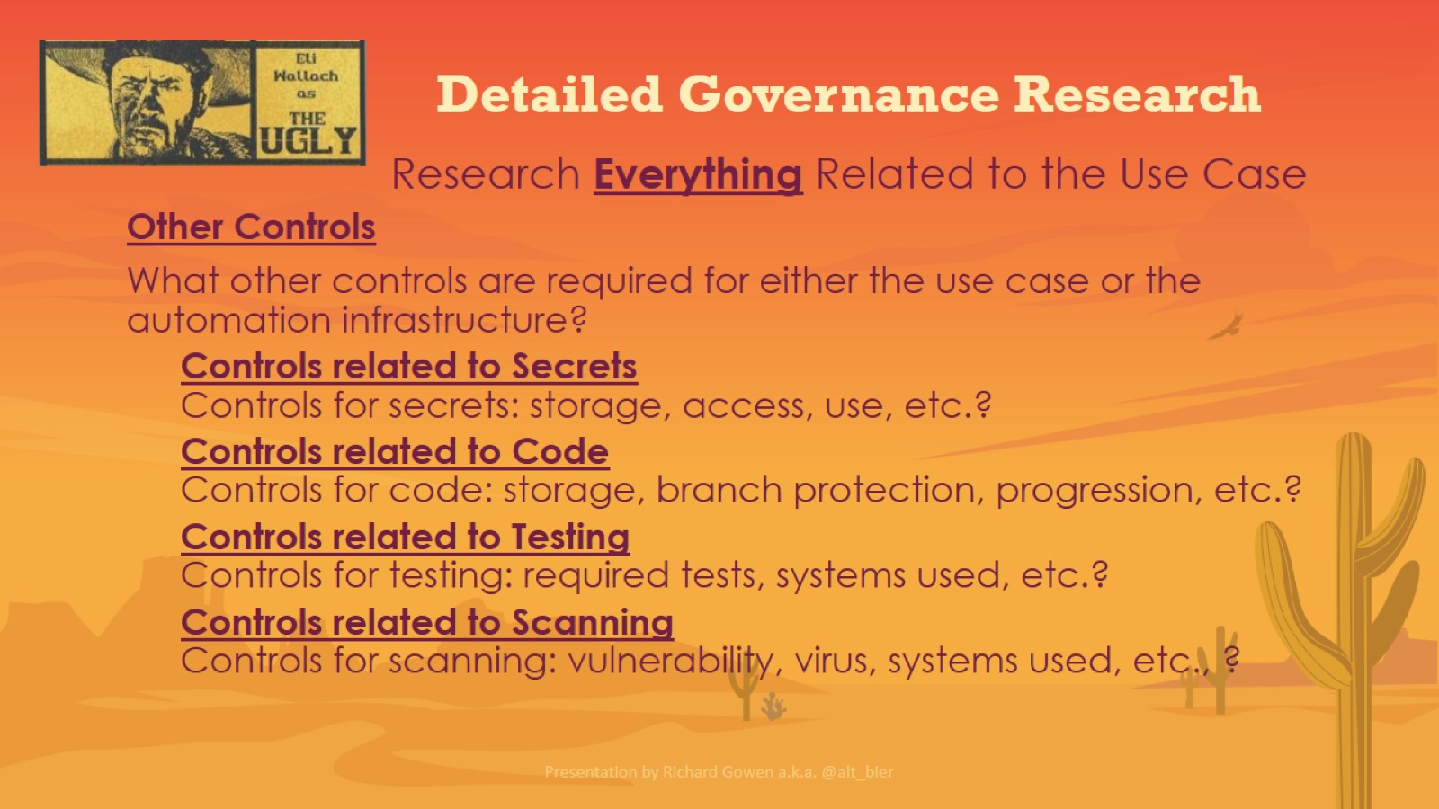
Detailed Governance Research

Slide 25
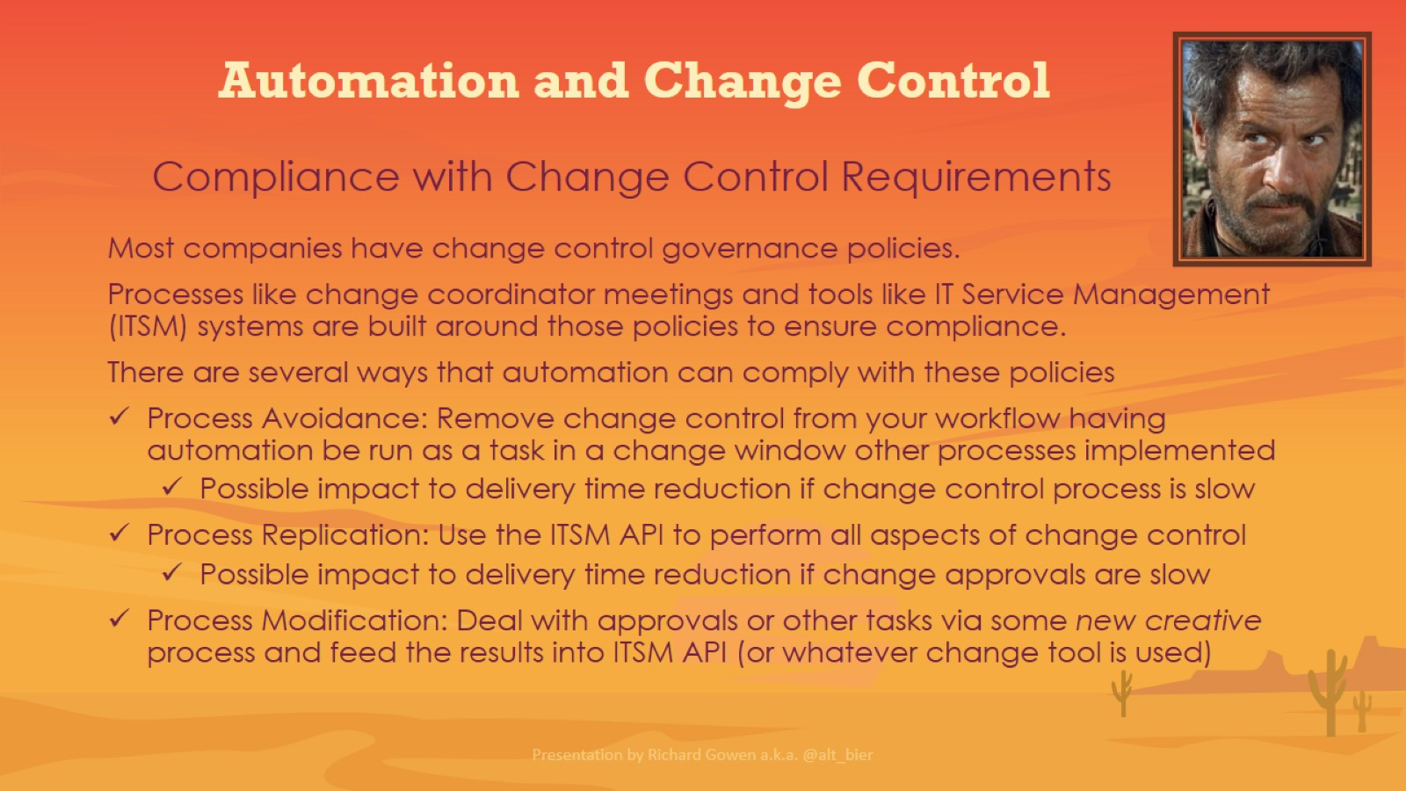
Automation and Change Control

Slide 26
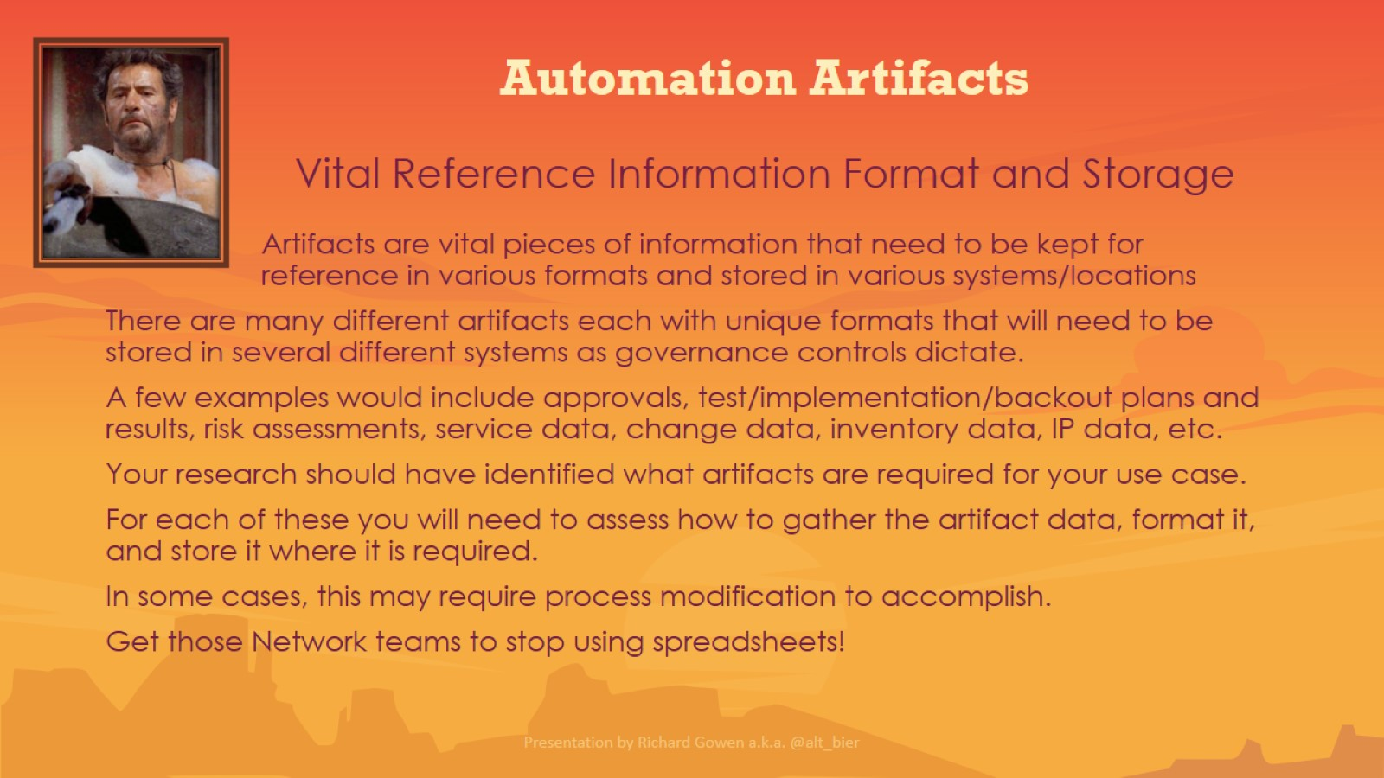
Automation Artifacts

Slide 27
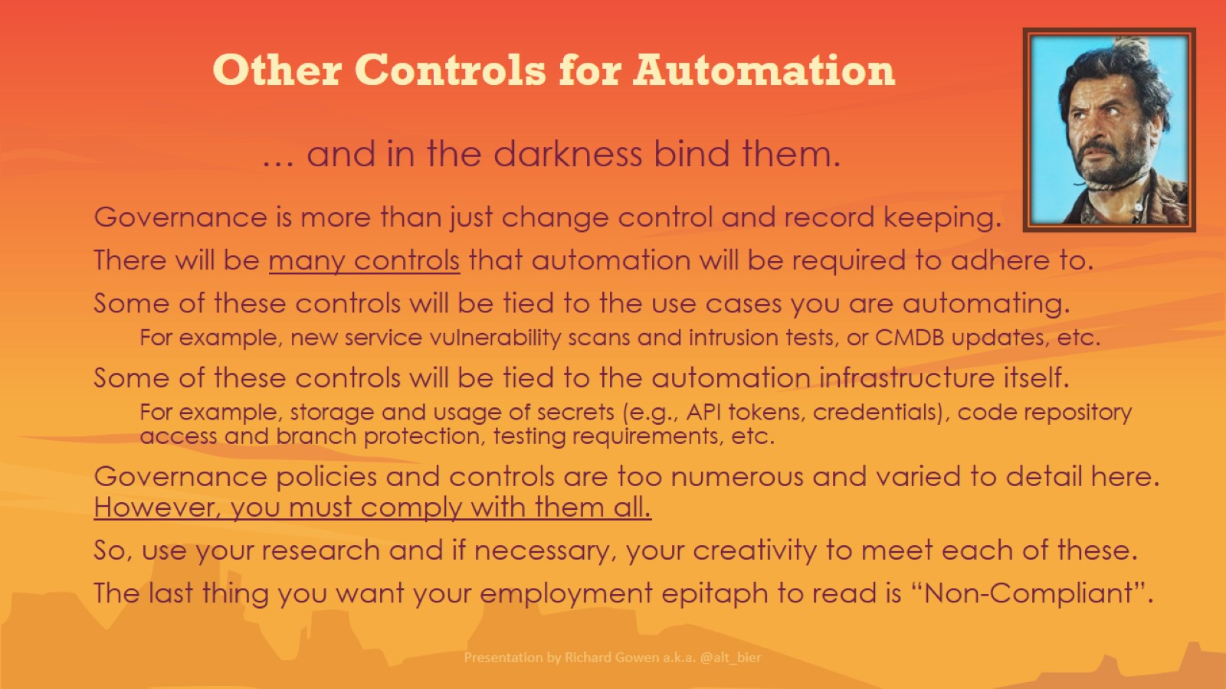
Other Controls for Automation

Slide 28
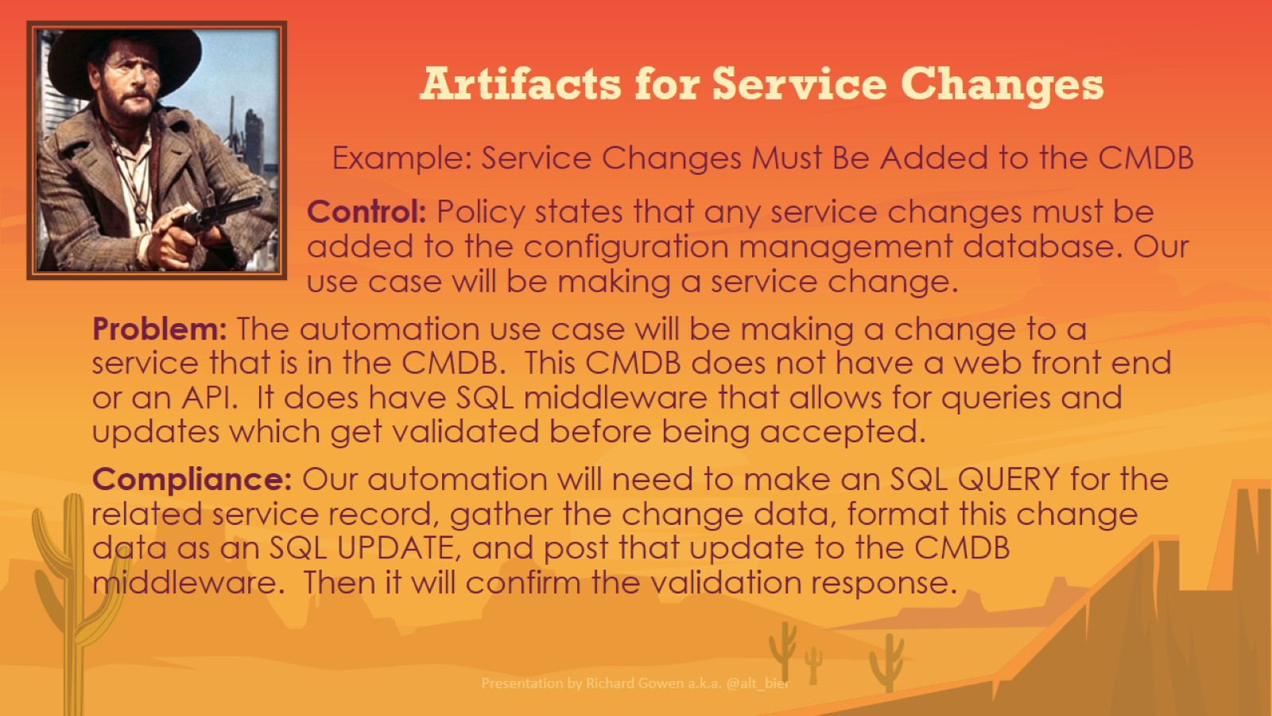
Artifacts for Service Changes

Slide 29
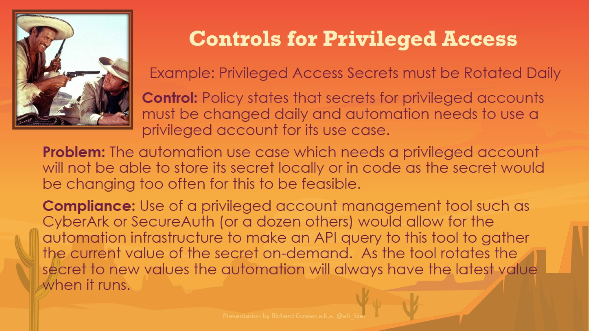
Controls for Privileged Access

Slide 30
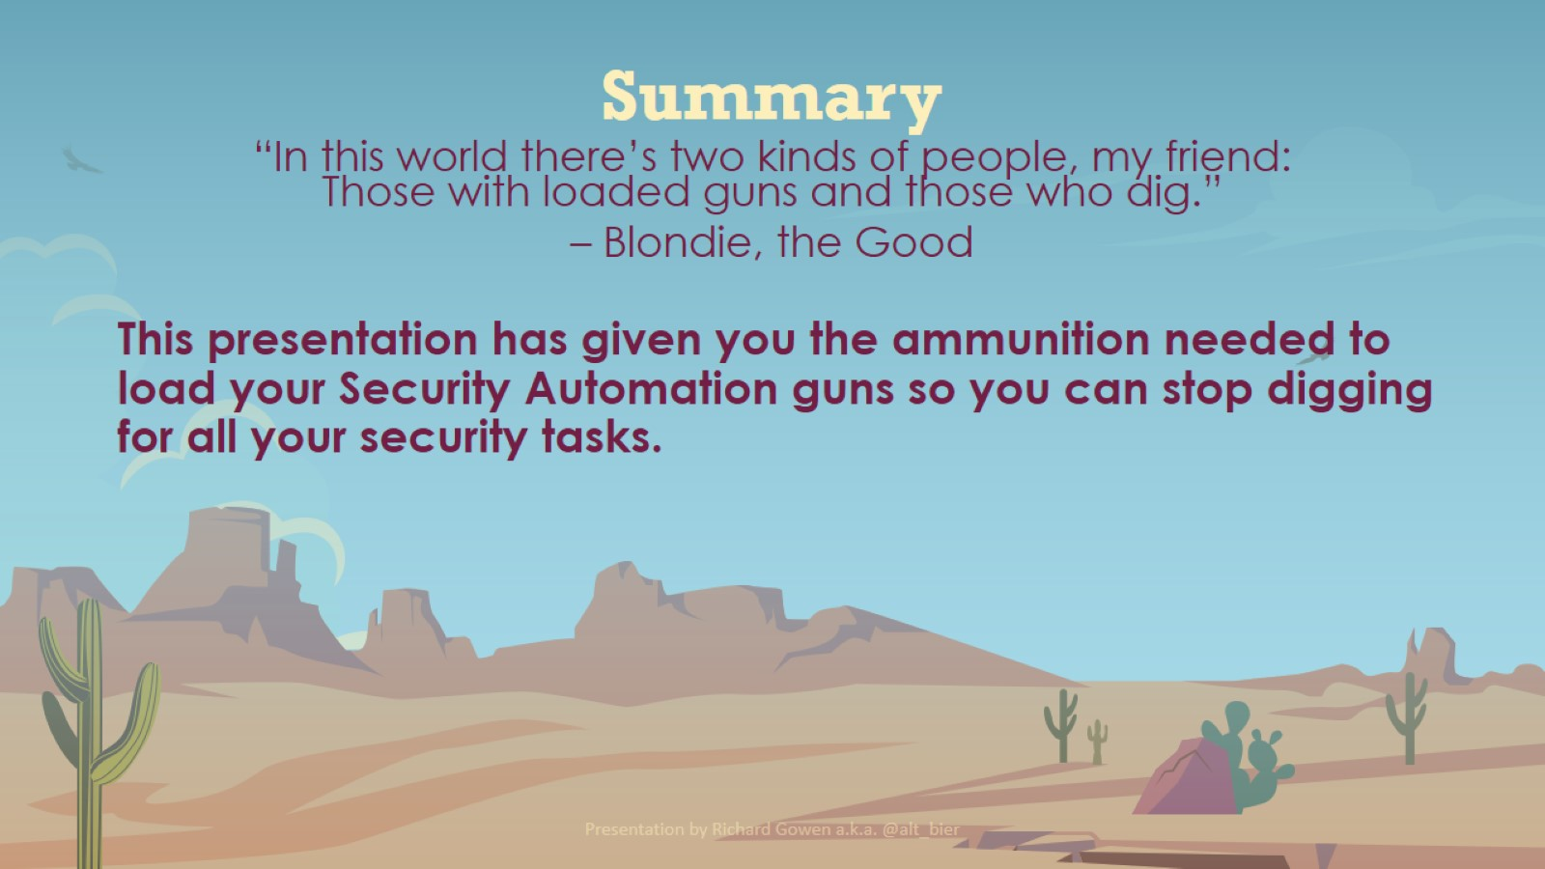
Summary

Slide 31
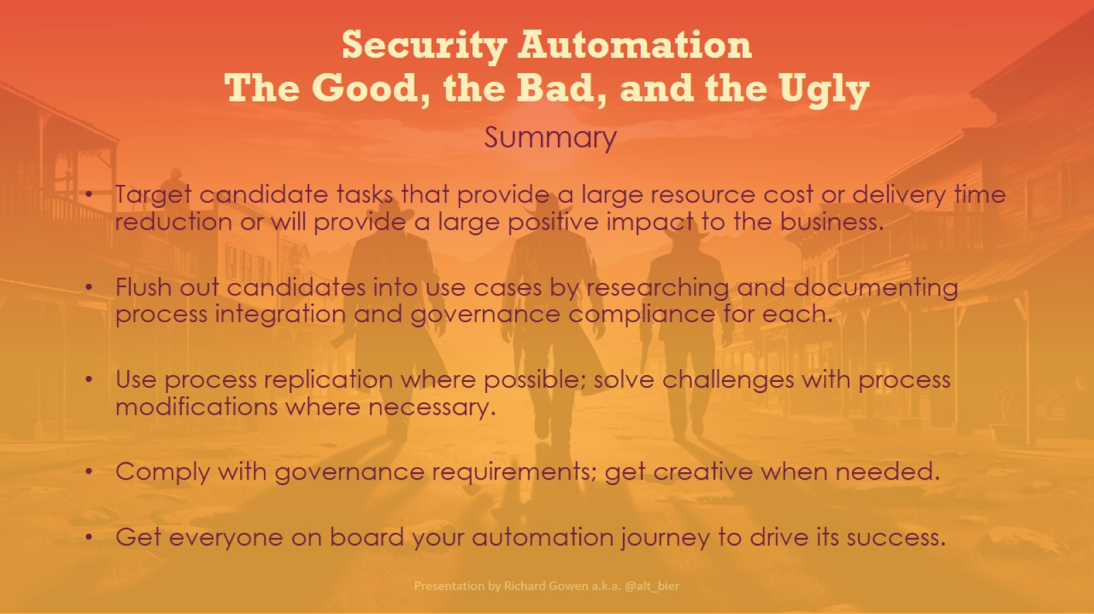
Security Automation The Good, the Bad, and the Ugly

Slide 32
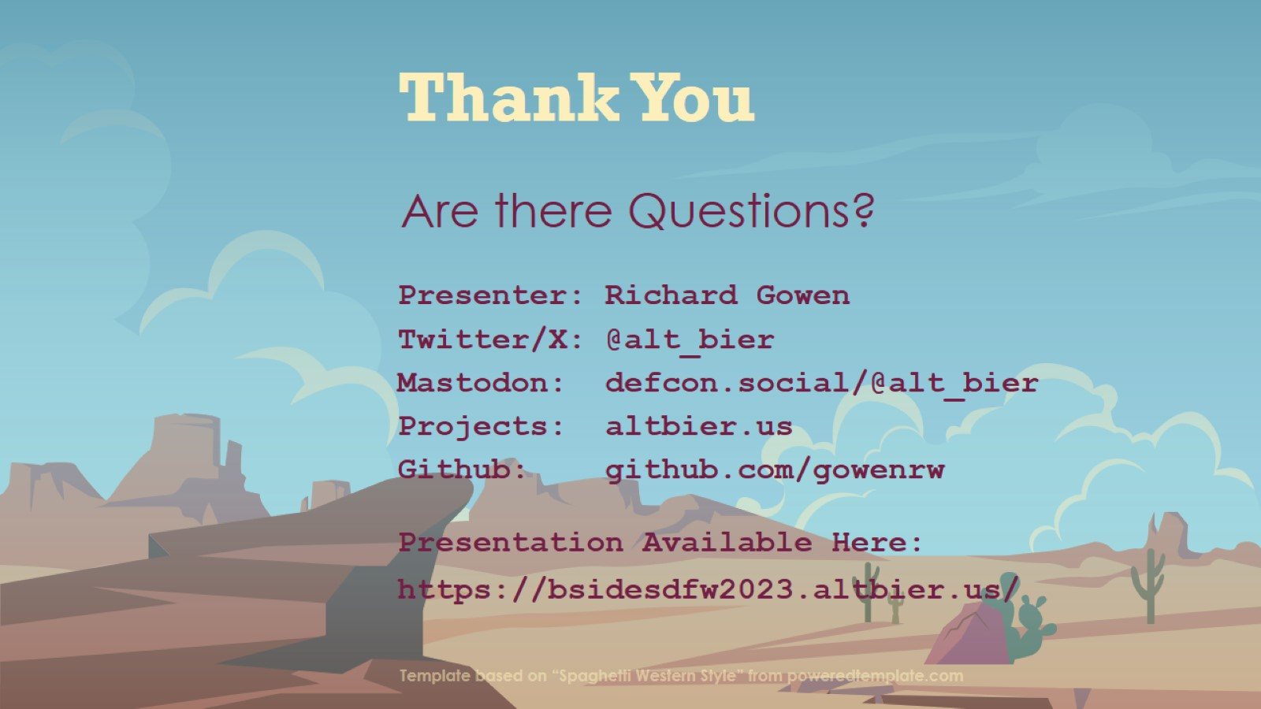
Thank You

